Slide 1
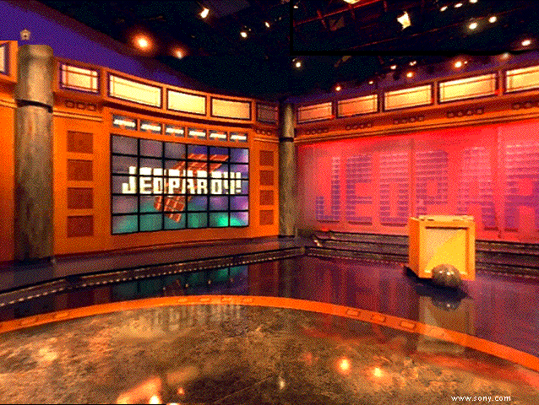

Hellie
Jeopardy!

Slide 2


Slide 3
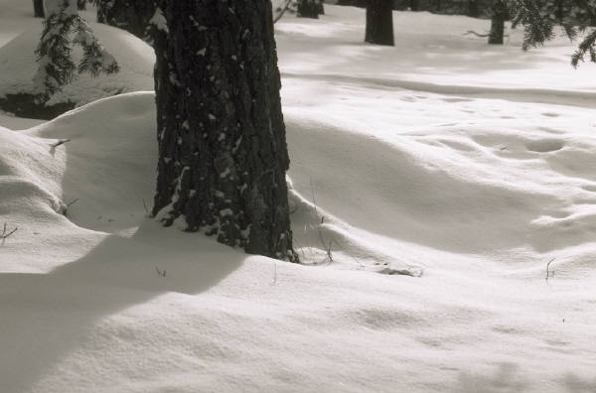


Genetics Jeopardy
DNA Structure | DNA -> Protein | This & That | Meiosis vs Mitosis | Probability
100
100
100
100
100
200
200
200
200
200
300
300
300
300
300
400
400
400
400
400
500
500
500
500
500
FINAL

Slide 4
DNA Structure 200
_{The shape of DNA}
Double Helix
===

Slide 5
DNA Structure 100
Components of the backbone of DNA
Alternating Phosphate and Sugar (deoxyribose)
===

Slide 6
DNA Structure 300
What makes up the rung of the ladder of DNA
Nitrogenous Bases
===

Slide 7
DNA Structure 400
What connects the bases?
===
Hydrogen Bonds

Slide 8
DNA Structure 500
Name 2 of the 3 differences in RNA structure compared to DNA
Single Stranded
Uracil instead of Thymine
Ribose instead of Deoxyribose
===

Slide 9
DNA -> Protein 100
Part of cell where transcription occurs.
Nucleus
===

Slide 10
DNA -> Protein 200
What does tRNA carry?
Amino acids
===

Slide 11
DNA -> Protein 300
What occurs during translation
mRNA codon attaches to tRNA codon bringing amino acid to make a protein
===

Slide 12
DNA -> Protein 400
Where translation occurs
Ribosome
===

Slide 13
DNA -> Protein 500
Arrange these steps of Protein Synthesis in the correct order
mRNA leaves nucleus
Amino acids bonded together
mRNA attaches to ribosome
DNA copied into mRNA
tRNA brings in amino acid
===
D-A-C-E-B

Slide 14
This and That 100
Of the three ways genetic variation is produced which one may lead to the creation of a new species
Gene Mutation
===

Slide 15
This and That 200
What needs to happen to DNA first to make a complementary strand?
Double Bonus: What enzyme is responsible for this
Strands must separate; Helicase
===

Slide 16
This and That 300
What are the base pairing rules for mRNA
A:U
G:C
===

Slide 17
This and That 400
DAILY DOUBLE
In a 40 base strand of DNA there are 28 Adenines (A). How many guanines are there?
===
12

Slide 18
This and That 500
What is the complementary mRNA strand to:
TTAGCATCA
AAUCGUAGU
===

Slide 19
MIT VS MEI 100
PURPOSE
MIT: growth, repair
^{MEI:} Genetic variation
===

Slide 20
Mit vs Mei 200
Type of Reproduction
Mit: Asexual; Mei: Sexual
===

Slide 21
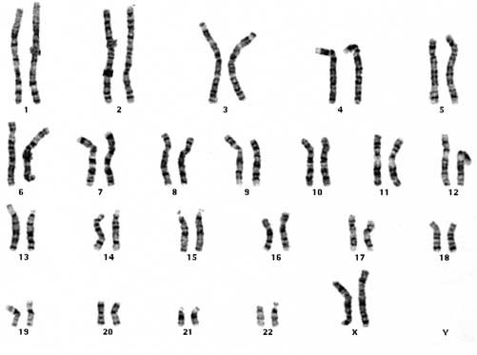
DAILY DOUBLE
What is the number of the homologous pair of chromosomes that determines sex?
What is the sex of this organism?
23
Female
===

Slide 22
Mit vs Mei 400
Where in the body
Mit: Body Cells; Mei: Sex Cells
===

Slide 23
Mit vs Mei 500
Daughter Cells (how many and describe them)
Mit: 2 identical diploid
Mei: 4 different haploid
===

Slide 24
Probability 100
When two F₁ organisms are crossed, what do we call the offspring?
F₂ Generation
===

Slide 25
Probability 200
If two hybrid black horses are crossed, what is the probability of the offspring being black?
3:1
Black : White
===

Slide 26
Probability 300
If a trait for height was inherited through incomplete dominance, what is the phenotypic ratio for a cross between a tall organism and a short organism?
0:4:0 All medium height
===

Slide 27
Probability 400
When two hybrid pink plants are crossed, the probability that a homozygous white plant will be produced is…
¼ or 25%
===

Slide 28
Probability 500
What is the ratio of phenotypes and sexes for a cross between a colorblind male and a hybrid female who is not colorblind.
X^{n}
Y
X^{N}
X^{N}X^{n}
X^{N}Y
X^{n}
X^{n}X^{n}
X^{n}Y
===
1:1:1:1
♀Normal: ♀colorblind: ♂Normal: ♂Colorblind

Slide 29
FINAL JEOPARDY!
1) What is the protein sentence to the following DNA Strand:
AGAGCTACC
Because I just got this

